Slide 1
SALE REPORT

Slide 2
SALE DETAILS OF LAST 8 YEARS
Sales Territory
Distribution of Orders
Country With Highest Sale
Year/Monthly Sale and Revenue
Top 5 Product in Demand
Top 10 Product In demand & its Revenue
Least 5 Products in Demand & its Revenue
Customer Details

Slide 3
Sale Table
TERRETORY | SALE
EMEA | 4979272
Spain | 1215687
France | 1110917
UK | 478880
Italy | 374674
Finland | 329582
Norway | 307464
Denmark | 245637
Germany | 220472
Sweden | 210014
Austria | 202063
Switzerland | 117714
Belgium | 108413
Ireland | 57756
NA | 3852061
USA | 3627983
Canada | 224079
APAC | 746122
Australia | 630623
Japan | 455173
Japan | 188168
Singapore | 172990
Philippines | 94016
KEY POINT INDICATOR
Highest sale region is Europe Middle East and Africa
Highest sale in EMEA Country is Spain and lowest is Ireland.
Lowest sales region is Japan
Lowest Sales Country in Japan territory phiIippines.

Slide 4

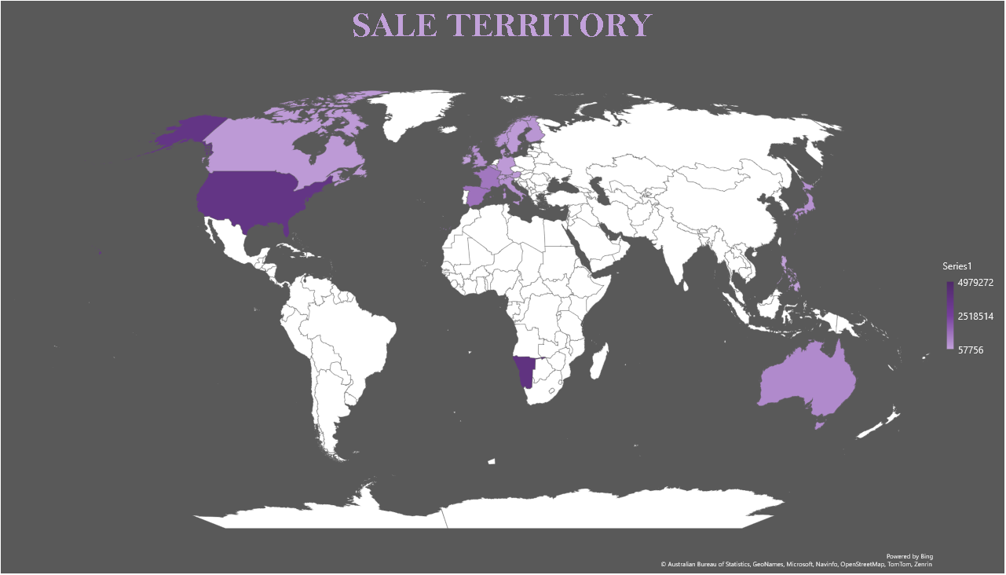

Slide 5
REGIONS | ORDER STATUS
ASIA PACIFIC | 221
EUROP THE MIDDLE EAST | 1407
JAPAN | 121
NORTH AMERICA | 1074

Slide 6

COUNTRY WITH HIGH SALE & REVENUE
COUNTRY | SALES | REVENUE
USA | 3627983 | 329407699
Spain | 1215687 | 108786575
France | 1110917 | 99968781
Australia | 630623 | 57053559
UK | 478880 | 42624710
Italy | 374674 | 33521870
Finland | 329582 | 29783959
Norway | 307464 | 28454975
Singapore | 288488 | 26349276
Denmark | 245637 | 22831579
Canada | 224079 | 20217017
Germany | 220472 | 19927793
Sweden | 210014 | 19306816
Austria | 202063 | 18607769
Japan | 188168 | 16828937
Switzerland | 117714 | 10918707
Belgium | 108413 | 9959233
Philippines | 94016 | 8349427
Ireland | 57756 | 5398107
KEY INDICATOR POINTS
Top 5 country with highest sales and revenue
Top 1 country with highest sale and revenue is USA
Least 5 country with Lowest sales and revenue
Country generating lowest sale and revenue in world is Ireland
Solution?

Slide 7
COUNTRY SALE & REVENUE

Slide 8
Sales Details On Time
MONTHS | SALES | REVENUE
Jul | 934455 | 85745493
May | 891119 | 80451732
Apr | 869533 | 78375084
Aug | 859098 | 78110996
Jun | 858603 | 77715002
Sep | 843607 | 76663934
Mar | 837537 | 75188022
Jan | 833714 | 74830191
Feb | 803943 | 73250507
Dec | 801856 | 72633245
Nov | 779148 | 71163321
Oct | 720017 | 64169266
KEY POINT INDICATOR
The sale and revenue is highest in month of July.
The sale and revenue is lowest is the month of October.
Solution ?

Slide 10
PRODUCTS SOLD QUANTITY
KEY INDICATOR POINTS :-
Top 3 Products which is sold mostly.
Lowest 2 product which does not sold mostly.
Product which is high in demand is Classic Car.
Product with lowest demand is Trains.
Product of the year is Classic cars
SOLUTION for least order product
PRODUCTS | QUANTITY
Classic Cars | 33992
Vintage Cars | 21069
Motorcycles | 11663
Trucks and Buses | 10777
Planes | 10727
Ships | 8127
Trains | 2712

Slide 11


Slide 12
TOP 10 REVENUE
Product | PRODUCT CODE | REVENUE
Classic model | S18_3232 | 28738833
Classic model | S10_1949 | 19107303
Motor Cycle | S10_4698 | 16946240
Classic model | S12_1108 | 16490816
Classic model | S18_2238 | 15435995
Classic model | S12_3891 | 14289064
Classic model | S24_3856 | 13964652
Motor Cycle | S12_2823 | 13919098
Plane | S18_1662 | 13809952
Truck & Bus | S12_1666 | 13575981
Products Generating highest revenue
Classic Model, Motor Cycle, Plane and Truck.
Product code s18_3232 generating highest revenue.
Price to the product Company

Slide 13

Classic
Car
Motor Cycle
Classic
Car
Motor cycle
Plan
Truck & Bus

Slide 14
LEAST 10 REVENUE
Product | PRODUCT CODE | REVENUE
Classic car | S18_3685 | 1046890
vintage car | S24_3151 | 1075800
classic car | S12_1108 | 1127920
vintage car | S18_3320 | 1133670
Classic car | S24_3856 | 1173970
motor cycle | S10_4698 | 1188660
Classic car | S18_3232 | 1188780
Classic car | S10_1949 | 1200100
vintage car | S18_2325 | 1253650
vintage car | S18_1749 | 1408280
Products Generating Lowest revenue
Classic Car , Vintage car and Motor Cycle.
Product code s18_3685 generating lowest revenue.
Solution

Slide 16

HAPPY CUSTOMER
Improve Order facility for Top Customer.
Provide Discount to Least 10 Customer.
Take Feedback From each Customer
Provide 24*7 Assistance for Customer Problem.

Slide 18

ANY QUESTIONS ?

